Slide 1
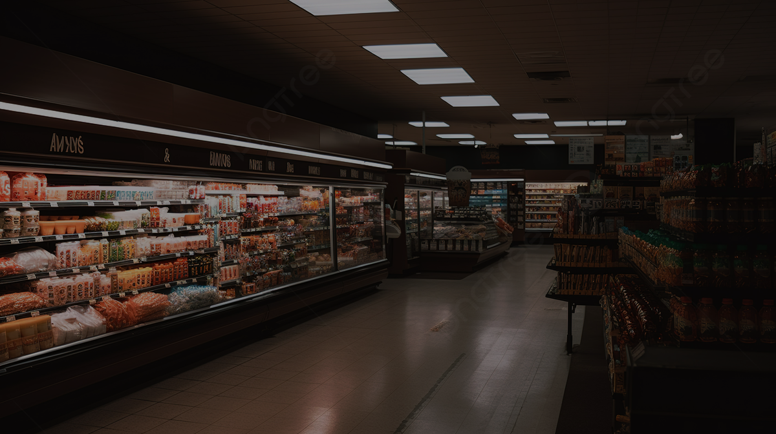
Top Shelf
An easier way to shop.

Slide 2






Tech Stack
Before we jump into the technical, here is a brief overview of the various technologies employed in the making of this application
Purpose | Technology
Front end | React with Bootstrap and MaterialUI
Back end | Spring Boot, Spring Security, Spring Web, Spring JPA, Hibernate, Tomcat, Rest APIs
Hosted on | AWS Cloud
Database Used | MySQL
VCS used | Github, Dockerhub
Notes:
Here you can see the tech stack that we have employed to create our website. Adding to this learnt some key concepts that helped us in our developer journey. Concepts like tackling dependencies, difference between functional and class component, , security and authorization along with learning about different libraries such as Bootstrap, Redux, Axios, react-router helped use ease the development process.
On the Backend side we employed Spring boot

Slide 3
Basic Flow
The basic flow of the website has been kept very simple with 5
distinct flows with separate business functions.
Supplier
Customer
Executive
Manager
Admin

Slide 4
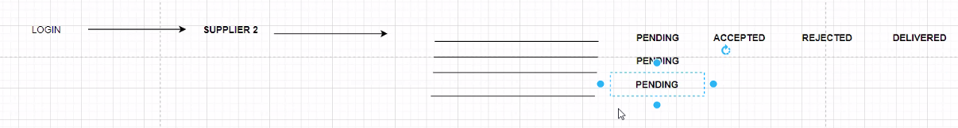
Supplier
Supplier is given orders by the executive
Supplier can mark an order as accepted or rejected
Supplier can mark the order as delivered, which allows a manager to then confirm its delivery at the designated warehouse

Slide 5
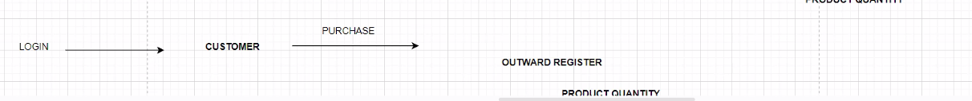
Customer
Customer chooses products (grouped) to add to cart
Customer can edit the card or checkout the card
Sales gets updated in the database

Slide 6
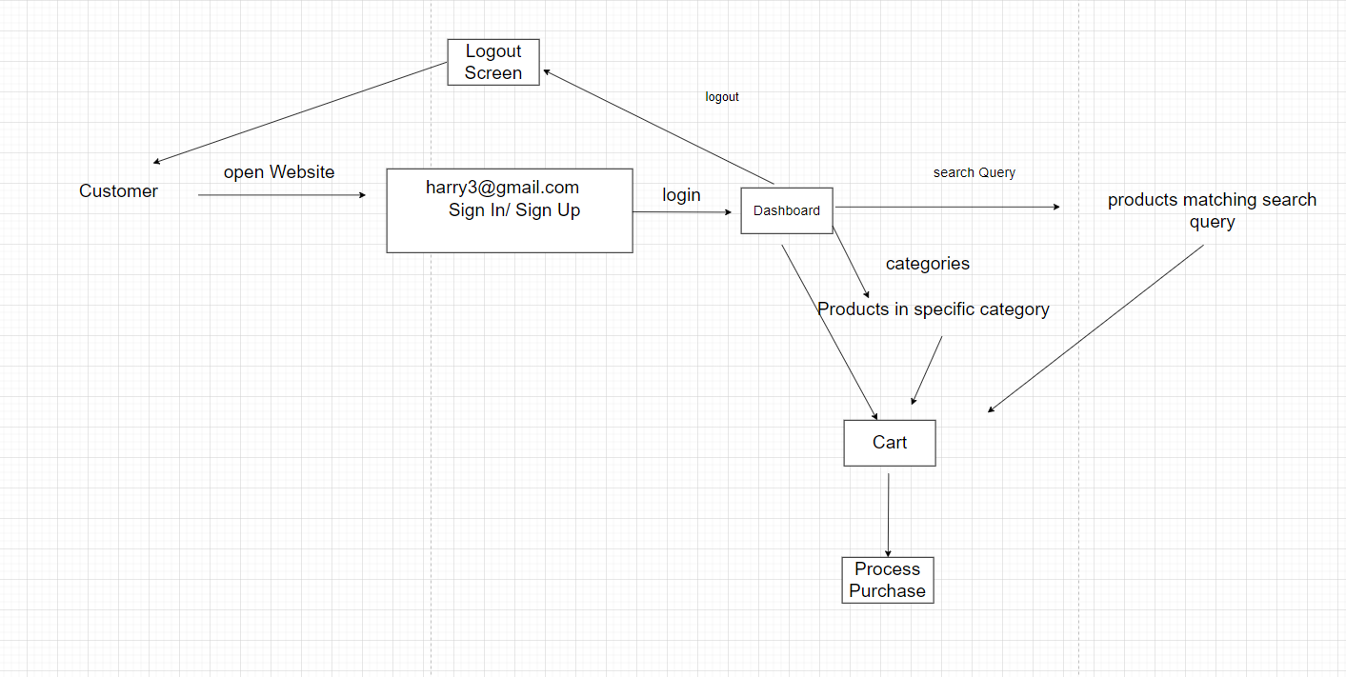
Customer Walkthrough

Slide 7
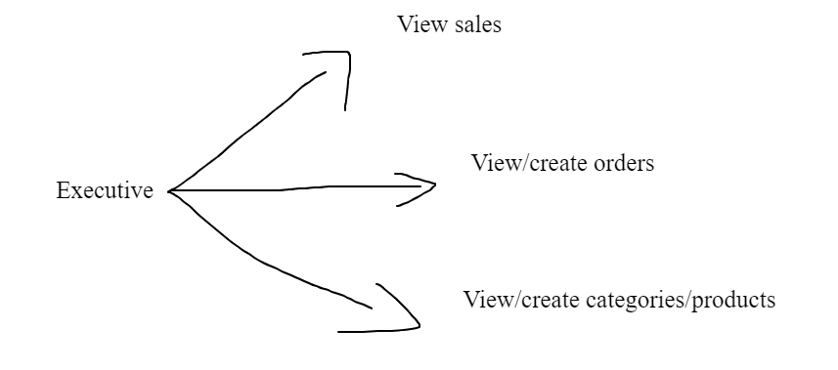
Executive
Executive can view all sales within a specified date period
Executive can view all orders and create orders for specified suppliers
Executive can view categories, view products, and create products/categories

Slide 8
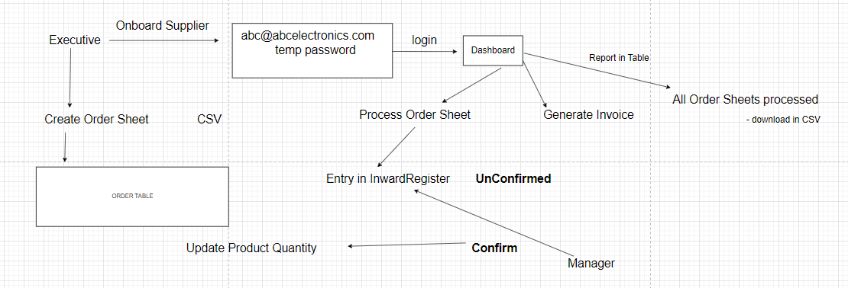
Executive Walkthrough
Divay

Slide 9
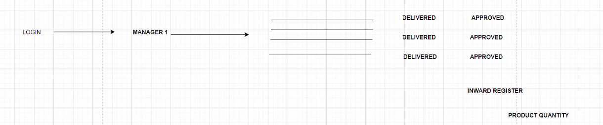
Manager
Suppliers will mark orders as delivered to the warehouse
The manager of the warehouse must mark the order as received to verify that they have received it

Slide 10
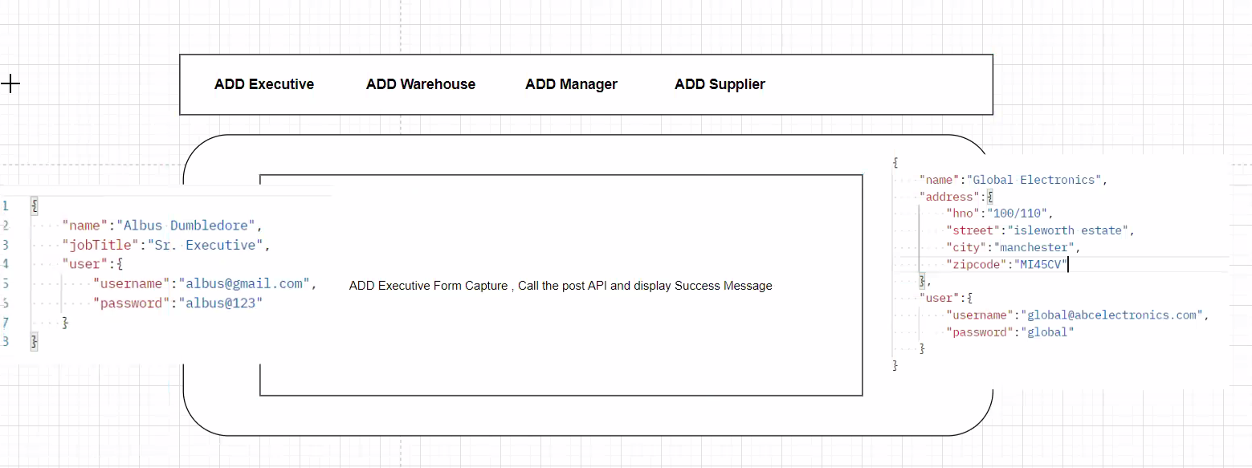
Admin

Slide 11
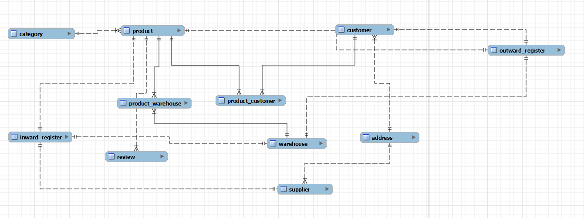
Database Tables Diagram

Slide 12

Frontend
REACT DEPENDENCIES USED:
materialsUI, Emotion, Redux.js, Axios, bootstrap, export-to-csv, Google Fonts, JWT-Decode, MDB React UI Kit, Primereact, React-router, web-vitals
THINGS LEARNED:
class-based components, functional components, life cycle hooks, local storage, security/authorization, States, React navigation, Axios API calls, fetch() API calls, Exporting data as CSV

Slide 13
Backend
TECHNOLOGIES USED:
Java, Hibernate, Maven, Rest API, Spring, JPQL Query Language, MySQL Workbench, Amazon Web Services Cloud,
Concepts Learned:
asynchronous/parallel processing, date-based logic and formatting, Controller layer, Service layer, Persistence layer, Spring Tool Suite, Model classes, POJO, enumeration, superclass/subclass architecture (inheritance), encapsulation, abstract classes, interfaces, polymorphism, Data access object, Data transfer objects, Exception Handling, Data structures: List, Maps, Sets, Custom comparator interfaces, Lambda functions, Runnable interface, ThreadPoolExecutor class, Custom security configuration, Rest Controllers, Services, and JPA Repository, Relationship tables, SQL Query Language

Slide 14
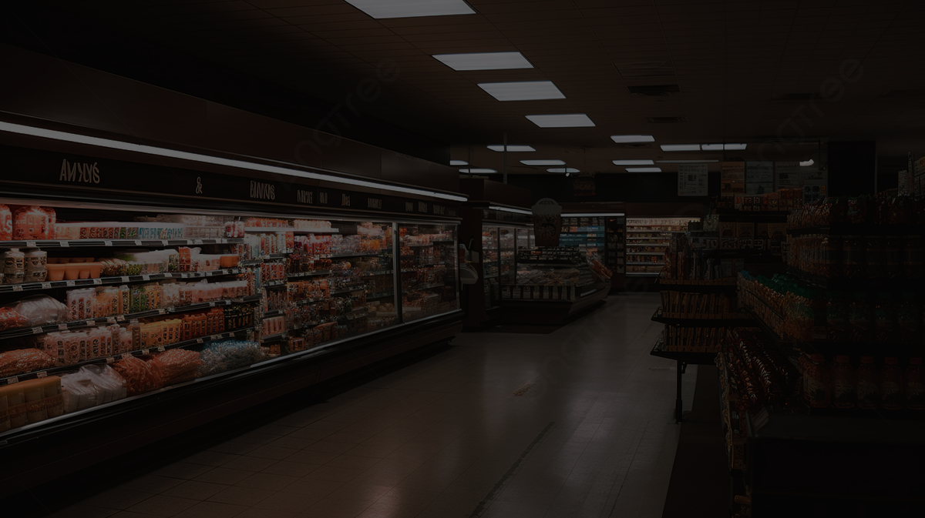
Thank You

